Slide 1








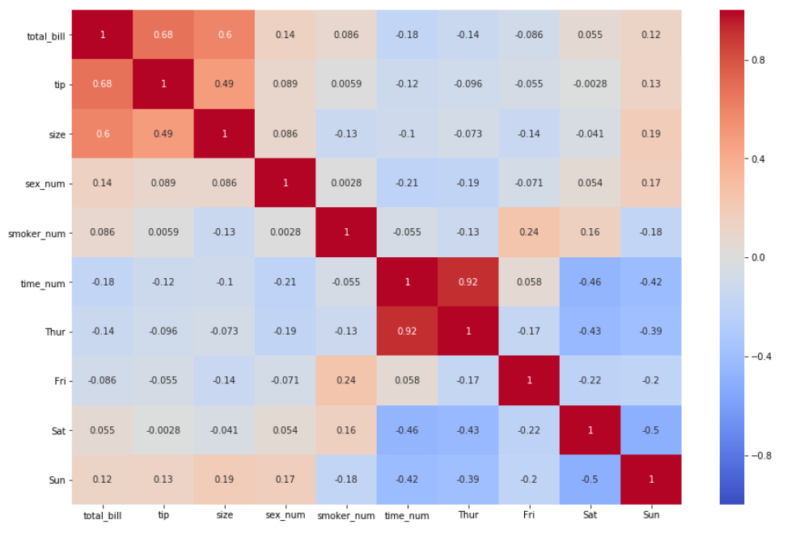

Cloudy With a Chance of Football (Cohort 23): Capstone Project Data Architecture (Expanded)
Data Ingestion
Data Limits
Years: 2019 and 2020
Positions: offense and whole-team defense
Platform: ESPN
players
player_id | unique_id | player_name
0 | tombrady | Tom Brady
1 | joshallen | Josh Allen
week_table
year | week | week_start | week_id
2019 | 1 | 20190907 | 2019_1
2019 | 2 | 20190914 | 2019_2
Columns
Column Name | Data Type | Unique Variables or Description
player_id | integer
unique_id | text | firstnamelastname
player_name | text | Firstname Lastname
year | integer | 2019 2020
week | integer
week_start | datetime | YYYY-MM-DD
week_id | text | YYYY_WW
position | text | qb, rb, te, wr, k
age | real
dob | datetime | YYYY-MM-DD
time_zone | integer | Hours away from Greenwich mean time of home time zone
team_name | text | Official team abbreviation codes
injury_status | integer | 0 : no injury 1 : questionable 2 : out
days_since_last_game | integer
hours_displaced | integer | Number of hours away from home time zone
temperature_min | integer
temperature_max | integer
precipitation | real
PassingYds | real
PassingTD | integer
Int | integer
PassingAtt | integer
Cmp | integer
RushingAtt | integer
RushingYds | real
RushingTD | integer
Rec | integer
Tgt | integer
ReceivingYds | real
ReceivingTD | integer
FL | integer
location | integer | 0 : away 1 : home
predicted | real | ESPN prediction for player fantasy points
actual | real | Actual number of ESPN fantasy points achieved
performance | integer | 0 : predicted < actual 1 : actual < predicted
game_time | integer | hours of day from 1 – 24 in home team time zone
week_day | integer | day of week during which game takes place, Monday = 0, Sunday = 6
Munging and Wrangling
positions
player_id | position
0 | qb
1 | qb
team_home_time_zone
team_name | week_id | time_zone
NE | 2019_1 | -5
BUF | 2019_1 | -5
x
player_age
player_id | week_id | age
0 | 2019_1 | 42.1
1 | 2019_1 | 25.52
NFL Savant
Individual player data
nflsavant_ingestor.py
nflsavant_cleaner_eda.ipynb
nflsavant.csv
player_dob
player_id | dob
0 | 19770803
1 | 19960521
player_team
player_id | week_id | team_name
0 | 2019_1 | NE
1 | 2019_1 | BUF
game_location
week_id | team_name | location
2019_1 | NE | 1
2019_1 | BUF | 0
Fantasy Football Data Pros
Weekly fantasy stats
2019 ESPN projection data
datapros_ingestor.py
datapros_cleaner_eda.ipynb
datapros.csv
days_since_last_game
team_name | week_id | days_since_last_game
NE | 2019_2 | 6
BUF | 2019_2 | 5
injury_status
player_id | week_id | injury_status
0 | 2019_1 | 0
1 | 2019_1 | 0
time_displacement_table
week_id | team_name | hours_displaced
2019_1 | NE | 0
2019_2 | BUF | 0
performance
player_id | week | predicted | actual | performance
0 | 2019_1 | 18.20 | 21.90 | 1
1 | 2019_1 | 29.35 | 27.10 | 0
0 | 2019_2 | 25.87 | 18.50 | 1
1 | 2019_2 | 19.93 | 28.98 | 1
Kaggle Data
2019 stats and 2020 projections
kaggle_cleaner_eda.ipynb
kaggle.csv
weather
week_id | team_name | temperature_min | temperature_max | precipitation
2019_1 | NE | 58 | 75 | .1
2019_1 | BUF | 35 | 48 | 3
kaggle_ingestor.py
opponents table
week_id | team_name | game_date | game_time | week_day | ARI | ATL | BAL | BUF | CAR | … | NO | NYG | NYJ | PHI | PIT | SF | SEA | TB | TEN | WAS
2019_1 | NE | 20190907 | 19 | 6 | 0 | 0 | 0 | 0 | 0 | … | 0 | 0 | 0 | 0 | 1 | 0 | 0 | 0 | 0 | 0
2019_2 | BUF | 20190906 | 12 | 6 | 0 | 0 | 0 | 0 | 0 | … | 0 | 0 | 1 | 0 | 0 | 0 | 0 | 0 | 0 | 0
Carnegie Mellon
Temperature and precipitation data
stats_table
player_id | week_id | PassingYds | PassingTD | Int | PassingAtt | Cmp | RushingAtt | RushingYds | RushingTD | Rec | Tgt | ReceivingYds | ReceivingTD | FL
0 | 2019_1 | 324 | 5 | 0 | 20 | 17 | 3 | 6 | 0 | 0 | 0 | 0 | 0 | 0
1 | 2019_1 | 405 | 4 | 0 | 32 | 25 | 4 | 12 | 0 | 0 | 0 | 0 | 0 | 0
cmu_ingestor.py
cmu_cleaner_eda.ipynb
cmu.csv
Reporting and Visualization
Operationalize machine learning models by exporting the models to python scripts, building an app with D3.js and Flask to accept basic user input and provide predictions on whether a player will over or under-perform in the 2021 NFL season
Machine Learning
Computation and Analysis
Using a correlation matrix, determine which features are important and would be useful in classifying over or under-performers
Use Pandas Shift to make previous week performance features useful in predicting time aware target variable or over or under-performing
Normalize all data from 0 to 1
Convert text data to integer data
Check on class imbalance and resolve class imbalance if detected
Conduct automated testing of scripts
Model 3: Running Backs
Model 2: Quarterbacks
Model 1: All players
12-fold time aware cross validation
train
 | train
 |  | train
 |  |  | train
 |  |  |  | train
 |  |  |  |  | train
 |  |  |  |  |  | train
 |  |  |  |  |  |  | train
 |  |  |  |  |  |  |  | train
 |  |  |  |  |  |  |  |  | train
 |  |  |  |  |  |  |  |  |  | train
 |  |  |  |  |  |  |  |  |  |  | train
Model 7: Defense
model3.ipynb
model2.ipynb
model1.ipynb
1 | Train
2
3
4
5
6
7
8
Model 6: Kickers
Model 5: Wide Receivers
Model 4: Tight Ends
model7.ipynb
9 | Test
10
model6.ipynb
model5.ipynb
model4.ipynb
80/20 train/test split

